Slide 1



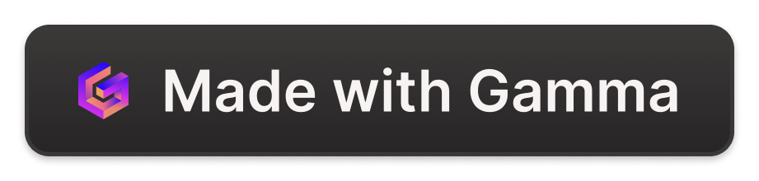
Basic Computer Science Knowledge in Daily Life
Explore the key components of computers and their importance in our daily lives, from CPUs and RAM to input/output devices.
by James Tzeng

Slide 2
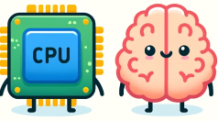
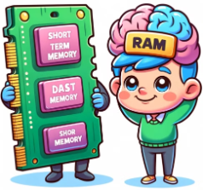
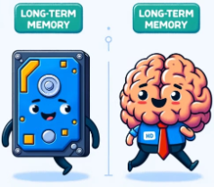
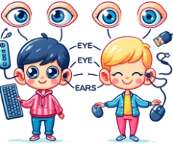
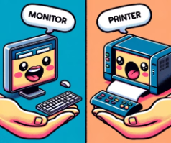
Analogy between Humans and Computers
Computers and humans share many similarities in the way they process information and carry out tasks.
The CPU acts as the brain, processing data and instructions.
RAM is akin to short-term memory, storing data temporarily.
The hard drive is like long-term memory, storing information persistently.
Input devices like the mouse and keyboard are similar to our eyes, ears, and hands, allowing us to interact with computers.
Output devices such as displays and speakers mimic our ability to see and hear the results of our interactions.

Slide 3
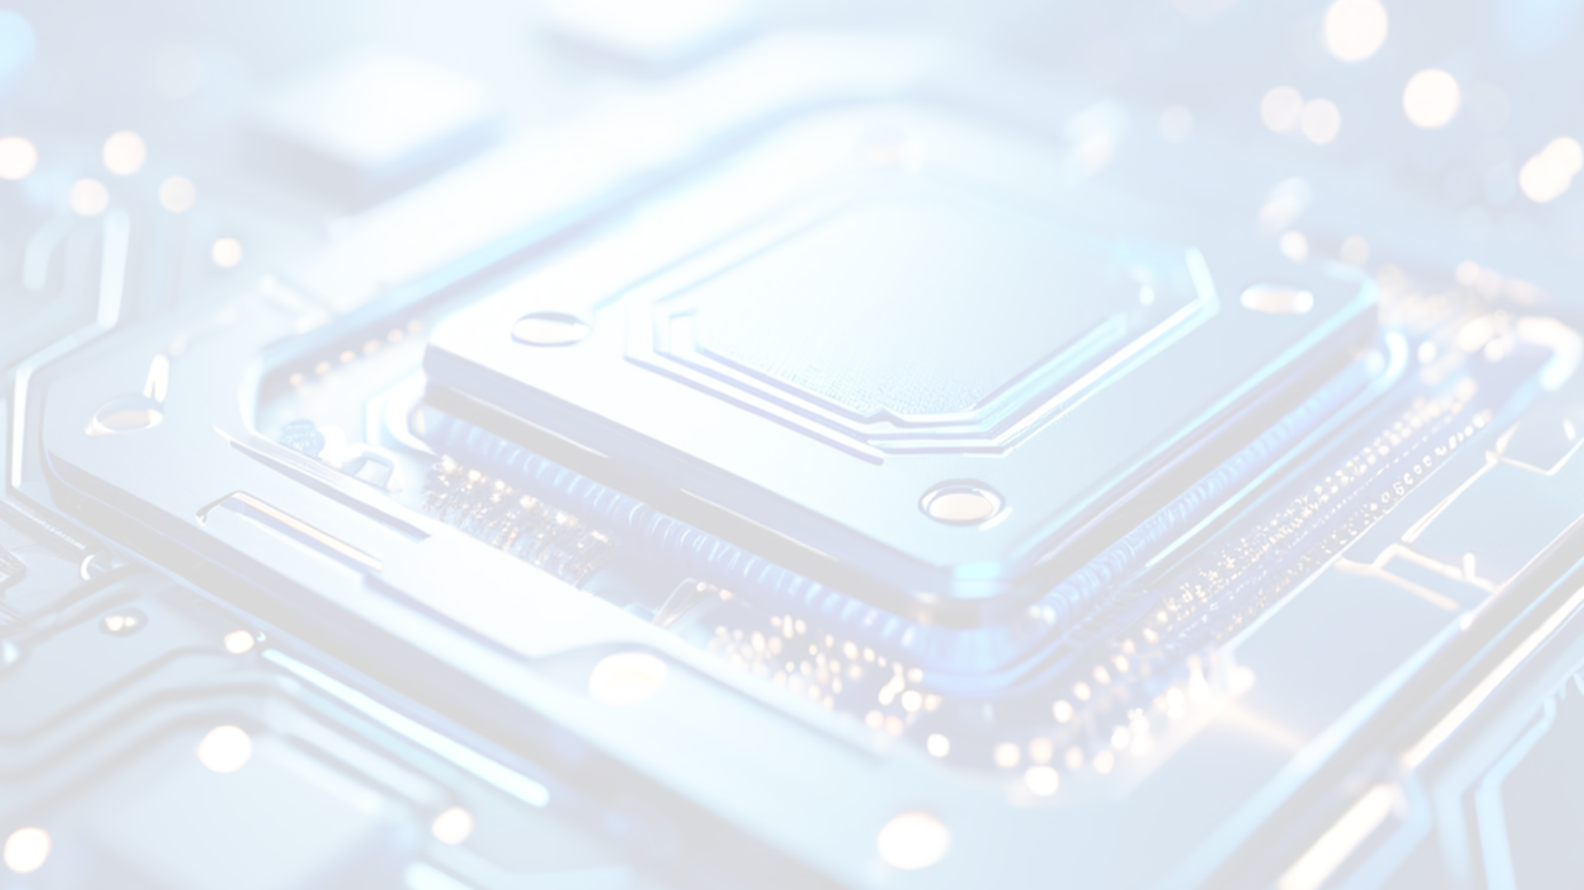
Understanding the CPU
1
The Brain of the Computer
2
Common CPUs
3
Importance in Daily Life
Intel Core, AMD Ryzen, and Qualcomm Snapdragon are popular CPU choices.
The CPU is responsible for executing instructions and powering our devices.
CPU performance affects the speed and responsiveness of our computers and phones.

Slide 4
Exploring RAM
Temporary Storage
Typical RAM Sizes
Importance in Daily Life
RAM provides the CPU with quick access to data and instructions.
8GB and 16GB for PCs, 4GB and 6GB for mobile phones.
More RAM enables smoother multitasking and better performance.

Slide 5
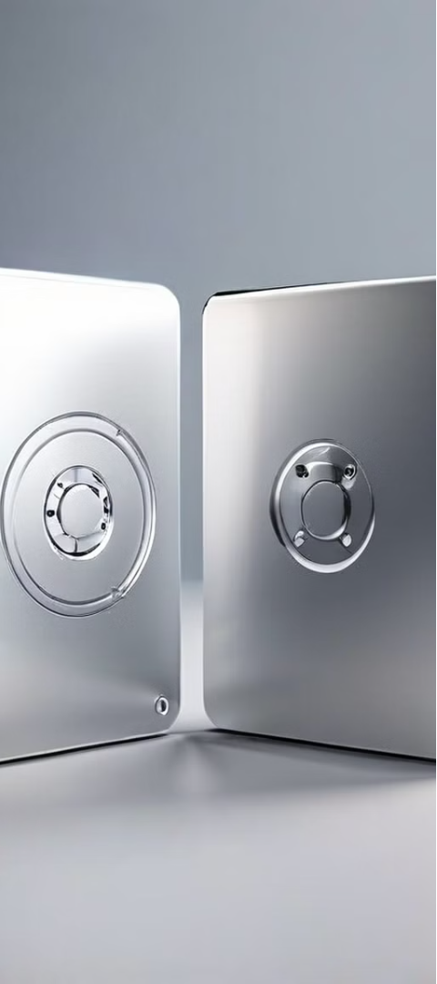
Understanding Storage
Permanent Storage
HDD vs. SSD
Hard drives (HDD) and solid-state drives (SSD) store our data.
HDDs offer more capacity, while SSDs provide faster speeds.
Importance in Daily Life
Storage capacity and speed impact how we use our devices.

Slide 6
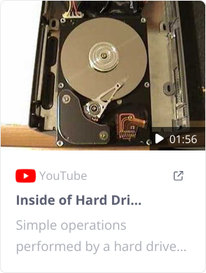
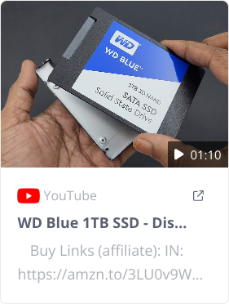
Comparison of HDD and SSD
Feature
HDD (Hard Disk Drive)
SSD (Solid State Drive)
Technology
Spinning magnetic disks
Flash memory
Speed
Slower data access and transfer speeds
Faster data access and transfer speeds
Durability
More prone to damage due to moving parts
More durable with no moving parts
Capacity
Larger storage capacities at lower cost
Smaller storage capacities, but increasing
Noise
Can be noisy due to moving parts
Silent operation
Power Consumption
Consumes more power
Consumes less power
Cost
Less expensive per gigabyte
More expensive per gigabyte
Inside

Slide 7


Input and Output Devices
Input Devices
Output Devices
Keyboards, mice, and scanners allow us to interact with computers.
Monitors, printers, and speakers display the results of our work.

Slide 8
Buying a PC
Assess Needs
Select RAM
Determine the purpose and set a budget for your PC.
More RAM enables better multitasking and performance.
1
2
3
4
Choose CPU
Decide on Storage
Select a CPU based on your performance requirements.
Balance speed (SSD) and capacity (HDD) for your needs.

Slide 9
Buying a Mobile Phone
Assess Needs
Select RAM
Determine the primary uses and set a budget for your phone.
More RAM improves the overall performance of your phone.
1
2
3
4
Choose CPU
Decide on Storage
Select a powerful CPU for better performance and multitasking.
Adequate storage is crucial for apps, photos, and videos.

Slide 10
Generational Improvements for Core i7
Generation
Example Model
Cores/Threads
Base Clock
Max Turbo Clock
Process Node
Key Features
Release Year
6th Gen
i7-6700K
4/8
4.0 GHz
4.2 GHz
14nm
Skylake architecture
2015
7th Gen
i7-7700K
4/8
4.2 GHz
4.5 GHz
14nm
Kaby Lake architecture
2017
8th Gen
i7-8700K
6/12
3.7 GHz
4.7 GHz
14nm
Coffee Lake, more cores/threads
2017
9th Gen
i7-9700K
8/8
3.6 GHz
4.9 GHz
14nm
Coffee Lake Refresh, higher core count
2018

Slide 11
Generational Improvements for Core i7
Generation
Example Model
Cores/Threads
Base Clock
Max Turbo Clock
Process Node
Key Features
Release Year
10th Gen
i7-10700K
8/16
3.8 GHz
5.1 GHz
14nm
Comet Lake, improved thermals
2020
11th Gen
i7-11700K
8/16
3.6 GHz
5.0 GHz
10nm
Rocket Lake, PCIe 4.0 support
2021
12th Gen
i7-12700K
12/20
3.6 GHz
5.0 GHz
10nm
Alder Lake, hybrid architecture
2021
13th Gen
i7-13700K
16/24
3.4 GHz
5.4 GHz
10nm
Raptor Lake, enhanced hybrid architecture
2022

Slide 12

Cores/Threads
A core in a CPU is a processing unit that reads and executes instructions, allowing the CPU to perform multiple tasks simultaneously

Slide 13

Conclusion
Understanding the key components of computers and mobile devices can help you make informed decisions when purchasing new technology. Remember to consider your needs and budget to find the right fit.

